Slide 1
MARKETING MANAGEMENT

Slide 2
INTRODUCTION
Good marketing is a result of careful planning and execution. The marketing practices are being continually being refined and reformed in virtually all industries to increase the chances of success. But marketing excellence is one which is rare and difficult to achieve. Marketing is both an “Art” and a “science”. Marketing requires creativity and passion to operate.

Slide 3
IMPORTANCE OF MARKETING
Financial success often depends on marketing ability.
Finance, operations, accounting, and other business functions will not matter if there is not sufficient demand for products and services.
It is the importance of marketing that highlights with many companies having now created a Chief Marketing Officer, or CMO, position to put marketing on a more equal footing with other C-level executives such as the Chief Executive Officer (CEO) and Chief Financial Officer (CFO).

Slide 4
Marketing is tricky and is now challenged
with newly empowered customers and
new competitors
making the right decisions is not always easy,
Marketing managers must make major decisions such as:
What features to design into a new product?
What prices to offer customers?
Where to sell products and
How much to spend on advertising or sales.
Detailed decisions such as the exact wording or color for new packaging.
Need to carefully monitor their customers and competitors and to continuously improve their value offerings.

Slide 5
THE SCOPE OF MARKETING
To be a good marketer, it is required to understand:
What marketing is?
How it works?
What is marketed and
Who does the marketing?

Slide 6
The FAQ’s related with marketing is:
How can we spot and choose the right market segment(s)?
How can we differentiate our offerings?
How should we respond to customers who buy on price?
How can we compete against lower-cost, lower-price competitors?
How far can we go in customizing our offering for each customer?
How can we grow our business?
How can we build stronger brands?
How can we reduce the cost of customer acquisition?
How can we keep our customers loyal for longer?
How can we tell which customers are more important?
How can we measure the payback from advertising, sales pro­motion, & public relations?
How can we improve sales force productivity?
How can we establish multiple channels and yet manage channel conflict?

Slide 7
What Is Marketing?
Marketing deals with identifying and meeting human and social needs. One of the shortest definitions of marketing is "meeting needs profitably"
The American Marketing Association gives a formal definition as:
Marketing is an organizational function and a set of processes for creating, communicating, and delivering value to customers and for managing customer relationships in ways that benefit the organization and its stake holders. Marketing management is seen as the art and science of choosing target markets and getting, keeping, and growing customers through creating, delivering, and communicating superior customer value.

Slide 8
Sample illustration:
The success of Indica, the first indigenously designed car in India by Tata Motors.
Backed by strong consumer insight, the company designed a vehicle with larger luggage space and legroom, and offered it at a price affordable to meet the typical Indian middle-class aspiration.
The company communicated Indica's value proposition of offering more space through the advertisement tagline "more car per car."
The subsequent introduction of Indigo and Marina expanded the product range of the company. Each of these introductions was backed by extensive market research.

Slide 9
How Marketing works?
Exchange, which is the core concept of marketing, is the process of obtaining a desired product from someone by offering something in return. For exchange potential to exist, five conditions must be satisfied:
There are at least two parties.
Each party has something that might be of value to the other party.
Each party is capable of communication and delivery.
Each party is free to accept or reject the exchange offer.
Each party believes it is appropriate or desirable to deal with the other party.

Slide 10
Sample illustration:
Mahindra and Mahindra (M&M) is a leader in the tractor market in India.
M & M, researches the benefits that a typical farmer wants when he buys a tractor.
These benefits include high quality equipment, a fair price, timely delivery, good financing terms, and reliable parts and service.
The want list are not equally important and may vary from buyer to buyer.
One of M&M's tasks is to discover the relative importance of these different wants to the buyer.
On the other hand M&M also has a want list. It wants a good price for the tractor, on-time payment, and positive word of mouth.
If there is sufficient match or overlap in the want lists, a basis of transaction exists. M&M's task is to formulate an offer that motivates the farmer to buy an M&M tractor.

Slide 11
What Is Marketed?
Marketing people are involved in marketing 10 types of entities:
Goods
Services
Experiences &
Events
Persons
Places
Properties
Organizations
Information, and
Ideas

Slide 12
Physical goods constitute the bulk of most countries' production and marketing effort. Each year, Indian companies market cars, trucks, television sets, machine tools, machines, industrial chemicals, watches, cosmetics and various other mainstays of a mod­ern economy.
As economies advance, a growing proportion of their activities are focused on the production of services. Services include the work of airlines, hotels, car rental firms, barbers and beauticians, maintenance and repair people, as well as professionals working within or for companies
Marketers promote time-based events, such as major trade shows, artistic performances, and company anniversaries. Global sporting events such as the Olympics or World Cup are promoted aggressively to both companies and fans. By orchestrating several services and goods, a firm can create, stage, and market experiences.

Slide 13

Celebrity marketing is a major business. Today many film stars have agents, personal managers and use the services of public-relations agencies. Many leading sports personalities use the services of professional sports marketing agencies to get endorsement contracts and to advertise them on personal brand building. Amitabh Bachchan, Sachin Tendulkar, Shah Rukh Khan are big brands themselves.

Slide 14
Properties are intangible rights of ownership of either real property (real estate) or financial property (stocks and bonds). Properties are bought and sold, and this requires marketing. Investment companies and banks are involved in marketing securities to both institutional and individual investors.
Organizations actively work to build a strong, favorable, and unique image in the minds of their target publics. Companies spend money on corporate identity ads. Philips, the Dutch electronics company, puts out ads with the tag line "Let's Make Things Better”, all use marketing to boost their public images and to compete for audiences and funds.
Information can be produced and marketed as a product. This is essentially what schools and universities produce and distribute at a price to parents, students, and communities. Encyclopedias and most nonfiction books market information. The production, packaging, and distribution of information are one of our society's major industries.

Slide 15
Who Markets?
A marketer is someone who seeks a response from another party, called the prospect. Marketers are skilled in stimulating demand for a company's products, marketers are responsible for demand management. Marketing managers seek to influence the level, timing, and composition of demand to meet the organization's objectives.
Four main demand states are possible:
Declining demand - Consumers begin to buy the product less frequently or not at all.
Irregular demand - Consumer purchases vary on a seasonal, monthly, weekly, daily, or even hourly basis.
Full demand - Consumers are adequately buying all products put into the marketplace.
Overfull demand - More consumers would like to buy the product than can be satisfied.

Slide 16
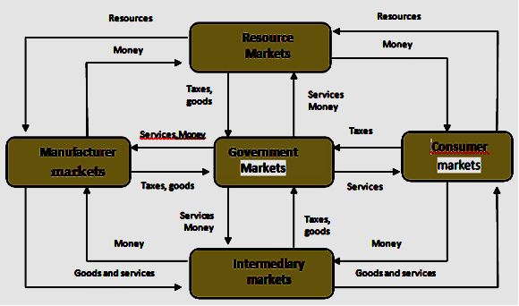
A "market" is a physical place where buyers and sellers gathered to buy and sell goods.
Manufacturers go to resource markets (raw material markets, labor markets, money markets), buy resources and turn them into goods and ser­vices, and then sell finished products to intermediaries, who sell them to consumers.

Slide 17
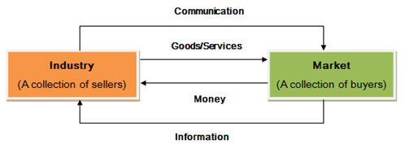
Marketing System

Slide 18
How Business and Marketing Are Changing
Changing technology. The digital revolution has created an Information Age. The Industrial Age was characterized by mass production and mass consumption, stores stuffed with inventory, ads everywhere, and rampant discounting. Today's business is carried on over electronic networks: intranet, extranets, and the Internet.
Globalization. Technological advances in transportation, shipping, and communication have made it easier for companies to market in other countries and easier for consumers to buy products and services from marketers in other countries.

Slide 19
Deregulation. Many countries have deregulated industries to create greater competition and growth opportunities. In India, the domestic airline industry has been growing very rapidly after deregulation. Airline companies are competing with each other by offering different and better services to customers.
Privatization. Many countries have converted public companies to private ownership and management to increase their efficiency.
Customer empowerment. Customers increasingly expect higher quality and service and some customization. They can obtain extensive product information from the Internet and other sources, which permit them to shop more intelligently.

Slide 20
Customization. The company is able to produce individually differentiated goods whether ordered in person, on the phone, or online. By going online, companies essentially enable consumers to design their own goods. The company also has the capacity to interact with each customer personally, to personalize messages, services, and the relationship.
Heightened competition. Brand manufacturers are facing intense competition from domestic and foreign brands, which is resulting in rising promotion costs and shrinking profit margins.

Slide 21
Industry convergence. Industry boundaries are recognizing that new opportunities and lie at the intersection of two or more indus­tries. Pharmaceutical companies, at one time essentially chemical companies, are now adding biogenetic research capacities in order to formulate new drugs, new cosmetics and new foods The shift to digital technology, in which devices needed to play entertainment content are more and more like PCs, is stimulating this massive convergence.
Retail transformation. Small retailers are succumbing to the growing power of giant retailers and "category killers." Store-based retailers are facing growing competition from catalog houses; direct-mail firms; newspaper, magazine, and TV direct-to-customer ads; home shopping TV; and e-commerce on the Internet. Sellers are making marketing an "experience" rather than a product assortment.

